Slide 1

Module 4
Circular Economy and Resource Efficiency
www.fairpreneurs.eu
Co-funded by the European Union. Views and opinions expressed are however those of the author or authors only and do not necessarily reflect those of the European Union or the Foundation for the Development of the Education System. Neither the European Union nor the entity providing the grant can be held responsible for them. KA220-YOU-DF4BEA29
This study is available under the CC BY-NC-SA license.

Slide 2
TABLE OF CONTENTS
01
Introduction to the Circular Economy
02
Business Models in a Circular Economy
03
Role of Technology and Digitalisation
04
Lean Management – How to Reduce Waste
05
The Global Perspective & Green Deal 2050
06
Country Policy

Slide 3

INTRODUCTION TO THE CIRCULAR ECONOMY
01

Slide 4

INTRODUCTION
The circular economy represents a fundamental shift in how we approach resource consumption and waste management.
Unlike the traditional linear economy, which follows a "take-make-dispose" model, the circular economy aims to keep resources in use for as long as possible, extracting maximum value from them and reducing waste and environmental impact.

Slide 5
PRINCIPLES OF THE CIRCULAR ECONOMY
Reducing waste and pollution involves designing products to be durable, reusable, and recyclable. This means optimising production processes to reduce waste and ensure that products can be efficiently reused or recycled so it is not the end of their life.
Keeping products and materials in use focuses on extending the lifecycle of products through repair, remanufacturing, and recycling. It also involves creating systems for sharing, leasing, and renting to increase the use of products and reduce the need for new materials.
Regenerating natural systems is about returning valuable nutrients to the environment and using renewable energy sources. This helps maintain ecosystem health and promotes a sustainable balance between industrial activities and nature.

Slide 6

BENEFITS FOR BUSINESSES
Adopting circular economy principles can provide businesses with numerous advantages:
Cost Savings: Improved resource efficiency reduces material and energy costs.
New Revenue Streams: Innovative business models such as product-as-a-service and remanufacturing open up new market opportunities.
Enhanced Brand Reputation: Commitment to sustainability can strengthen brand loyalty and attract environmentally conscious consumers.
Regulatory Compliance: Staying ahead of environmental regulations and standards.
Supply Chain Resilience: Reducing dependency on raw materials and minimising risks associated with supply chain disruptions.

Slide 7


SDG & ENTRECOMP ALIGNMENT
SDG9 (Industry, Innovation, and Infrastructure): Promotes sustainable industrialisation and encourages innovation.
SDG 12 (Responsible Consumption and Production): Encourages sustainable production and consumption patterns.
SDG 13 (Climate Action): Reduces greenhouse gas emissions and promotes climate resilience.
EntreComp 1.2 (Creativity): Encourages innovative approaches to resource management and waste reduction.
EntreComp 3.1 (Taking the initiative): Motivates individuals to take proactive steps in implementing circular economy practices.

Slide 8

SUGGESTED PRACTICAL EXERCISE
Circular Product Design
Objective: Design a product that incorporates circular economy principles.
Instructions: Work in teams to create a product concept that is durable, repairable, and recyclable. Outline the lifecycle of the product and present a sustainability plan.
Example: Design a smartphone that allows users to easily replace or upgrade parts, extending the product’s life and reducing electronic waste.

Slide 9

FURTHER RESOURCES
It’s time for a circular economy – Ellen MacArthur Foundation
Circular economy: definition, importance and benefits

Slide 10
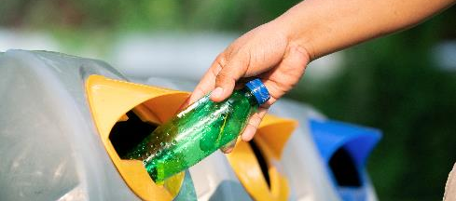
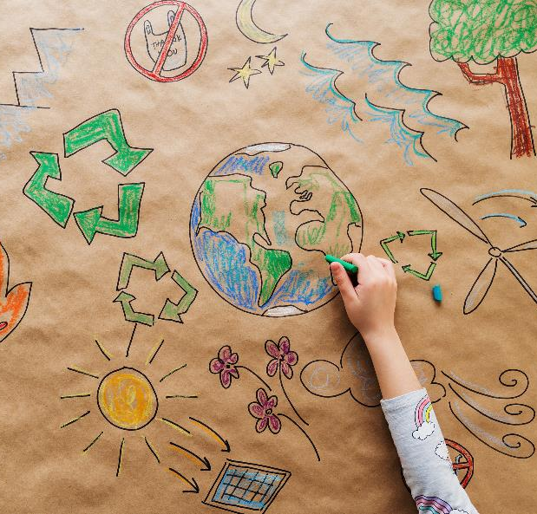


Slide 11

BUSINESS MODELS IN A CIRCULAR ECONOMY
02

Slide 12

INTRODUCTION
Circular business models are innovative approaches that focus on sustainability and resource efficiency by rethinking product and service delivery.
Key models include product-as-a-service, where customers pay for usage rather than ownership; remanufacturing, which restores used products to like-new condition; and sharing platforms, which maximise asset use through shared access.
12

Slide 13

PRODUCT-AS-A-SERVICE (PAAS)
The concept of Product-as-a-Service (PaaS) shifts the traditional business model from selling products to offering them as services.
Instead of owning the products, customers pay for the usage, which ensures a more sustainable lifecycle for the items. This model ensures that the products are returned and reused, significantly reducing waste.
The benefits of PaaS: it reduces waste by keeping products in use longer, extends the product lifecycle through maintenance and reuse, and creates continuous revenue streams for businesses, as customers subscribe to the service rather than making a one-time purchase.

Slide 14

REMANUFACTURING
Remanufacturing is a process where companies restore used products to a like-new condition, ensuring they meet high quality and performance standards.
This approach saves substantial amounts of materials and energy that would otherwise go into producing new products from scratch.
The benefits of remanufacturing are significant: it conserves valuable resources, reduces production costs, and minimises the environmental footprint by reusing existing materials and components.

Slide 15

SHARING PLATFORMS
Sharing platforms encourage the sharing of products or resources among multiple users, increasing their life-span and reducing the need for new products.
This model enhances reduction in the environmental impact associated with producing new goods, and creates a sense of community by encouraging shared use of resources.
The benefits are clear: sharing platforms not only lower costs for consumers but also promote sustainable consumption patterns by making better use of existing assets.

Slide 16
SDG & ENTRECOMP ALIGNMENT
SDG 9 (Industry, Innovation, and Infrastructure): Promotes innovative business models that enhance industrial sustainability.
SDG 12 (Responsible Consumption and Production): Encourages efficient resource use and waste reduction through innovative business models.
SDG 8 (Decent Work and Economic Growth): Creates sustainable economic growth through innovative business models.
Competence Area 1.5 (Ethical and sustainable thinking): Encourages consideration of environmental impacts in business decisions.
Competence Area 3.1 (Taking the initiative): Drives proactive implementation of innovative business models for sustainability.

Slide 17


Best Practices:
Beyond Leather Materials APS
Beyond Leather Materials APS stands out for its commitment to the circular economy in textile production.
By creating high-quality, sustainable alternatives to traditional leather from recycled materials, they embody the principles of resource efficiency and waste reduction.

Slide 18

Their closed-loop production system significantly cuts down on waste and resource use, setting a benchmark for sustainability in the fashion industry.
Beyond Leather Materials APS not only showcases how circular economy practices can be effectively implemented but also highlights the environmental benefits of adopting such approaches.
For a better look into their circular economy practices, visit our Compendium of Case Studies.

Slide 19
SUGGESTED PRACTICAL EXERCISE
Circular Supply Chain Mapping
Objective: Map a circular supply chain for a chosen product.
Instructions: Identify suppliers, production processes, distribution methods, and end-of-life processes. Propose improvements for sustainability.
Example: Map the supply chain of a coffee company, identifying opportunities for using recycled materials, reducing waste, and implementing a take-back program for coffee grounds.
Tools Needed: Paper & Markers/Whiteboard, Sticky Notes, Posters/Large Sheets, Research Materials, Templates.

Slide 20
Further Resources
Press Release: Circular Business Models
– Ellen MacArthur Foundation
Remanufacturing for the circular economy: Study and evaluation of critical factors

Slide 21

ROLE OF TECHNOLOGY AND DIGITALISATION
03

Slide 22


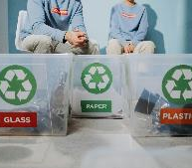
Blockchain
Blockchain technology offers a secure and transparent way to track the lifecycle of products and materials. For example, companies use blockchain to authenticate recycled materials, ensuring that quality standards are met and promoting trust in circular economy practices.
The Internet of Things (IoT)
The Internet of Things (IoT) connects physical objects to the internet, enabling real-time monitoring for efficient resource management. For example, smart sensors in manufacturing predict maintenance needs, reducing downtime and extending machinery life.
Digital Tools for Waste Management
Digital platforms and applications streamline waste management processes, improve recycling rates, and promote circular practices across industries.

Slide 23

IOT IN CIRCULAR ECONOMY
The Internet of Things (IoT) plays a crucial role in the circular economy by monitoring resource usage, tracking product lifecycles, and optimising operational efficiencies in circular supply chains.
IoT devices and sensors provide real-time data, enabling businesses to make informed decisions and reduce waste.
For example, smart bins equipped with sensors can track waste levels and optimise collection routes, thereby reducing fuel consumption and emissions.

Slide 24

BLOCKCHAIN FOR SUPPLY CHAIN TRANSPARENCY
Blockchain technology enhances transparency, traceability, and accountability in supply chains.
By creating immutable records, blockchain ensures that all transactions are visible and verifiable, promoting ethical practices and reducing environmental impact.
For instance, a blockchain system can track the sourcing of raw materials in the fashion industry, ensuring that sustainable and ethical practices are followed.

Slide 25

DIGITAL TOOLS FOR WASTE MANAGEMENT
Digital tools and platforms streamline waste management processes, improve recycling rates, and promote circular practices across industries.
These tools can include apps for waste sorting, platforms for managing recycling logistics, and software for tracking waste generation and diversion.
For example, a digital platform can coordinate recycling efforts across a city, improving efficiency and increasing recycling rates.

Slide 26
ENABLING RESOURCE TRACKING, PRODUCT TRACEABILITY, AND CIRCULAR SUPPLY CHAIN MANAGEMENT
Technology enhances the circular economy by enabling precise tracking of resources and products. This transparency ensures materials are reused, recycled, or returned to the ecosystem efficiently.
Resource Tracking: IoT devices and blockchain technology can track the flow of materials in real-time, ensuring they are used efficiently and returned to the supply chain.
Product Traceability: Blockchain provides an immutable record of a product's journey, ensuring transparency and accountability in sourcing and recycling.
Circular Supply Chain Management: AI and IoT optimise supply chain operations, reducing waste and enhancing the sustainability of logistics and production processes.

Slide 27
BENEFITS OF TECHNOLOGY INTEGRATION
Integrating technology in the circular economy offers numerous benefits. It improves resource efficiency by enabling maintenance, optimising resource allocation, and reducing energy consumption.
Digitalisation enhances supply chain resilience by providing real-time insights into inventory levels, demand fluctuations, and supplier performance, thereby reducing risks and improving business continuity.
As well as this then, technology-driven solutions inspire innovation, accelerate the adoption of circular business models, and encourage change towards sustainable development.

Slide 28
SUSTAINABLE DEVELOPMENT GOALS ALIGNMENT
SDG 9 (Industry, Innovation, and Infrastructure): Using technology for sustainable industrial practices enhances infrastructure resilience and promotes innovation in circular economy solutions.
SDG 11 (Sustainable Cities and Communities): Smart technologies contribute to urban sustainability by improving resource management, reducing environmental impact, and enhancing quality of life.
SDG 12 (Responsible Consumption and Production): Technology supports responsible consumption and production patterns by optimising resource use, reducing waste, and promoting sustainable practices.

Slide 29
ENTRECOMP ALIGNMENT
EntreComp 1.2 (Creativity): Exploring digital solutions for sustainable resource management encourages creativity in developing innovative approaches to circular economy challenges.
EntreComp 3.1 (Taking the initiative): Implementing technology-driven circular solutions requires initiative in identifying opportunities, making strategic decisions, and driving digital transformation in business operations.

Slide 30
Further Resources
IoT for Sustainability — How IoT is changing the world
What is the internet of things (IoT)?
The Role of Blockchain in Supply Chain Management (SCM)

Slide 31
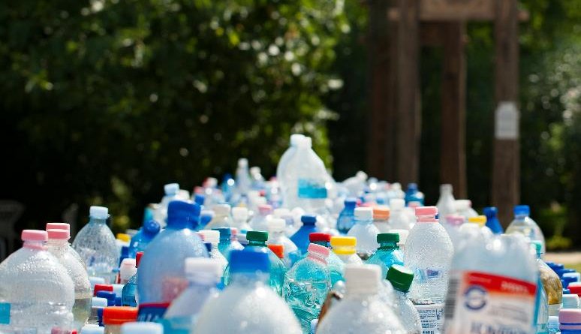
LEAN MANAGEMENT - HOW TO REDUCE WASTE
04

Slide 32

INTRODUCTION
Lean management focuses on increasing value while reducing waste within business operations.
It aims to create more efficient processes by eliminating non-value-adding activities, thereby improving productivity and reducing costs.
The core idea is to deliver more value to customers using fewer resources.
32

Slide 33
ADVANTAGES OF LEAN MANAGEMENT
Implementing lean management principles offers numerous benefits. It reduces lead times, enhances product quality, and improves on-time delivery performance, thereby increasing customer satisfaction and loyalty.
Lean practices also reduce operational costs, optimise resource usage, and reduce waste generation, aligning with environmental sustainability goals.
Lean methodologies improve workplace safety, employee engagement, and organisational resilience by creating a culture of continuous improvement and innovation.'

Slide 34

VALUE STREAM MAPPING
Value stream mapping (VSM) is a powerful tool used to visualise and analyse the flow of materials and information from the raw material stage to the delivery of the finished product to the customer.
By mapping out each step in the process, including both value-adding and non-value-adding activities, organisations can identify inefficiencies and areas of waste.
For example, in a manufacturing setting, value stream mapping may reveal excessive inventory buildup or unnecessary transportation between production stages.

Slide 35

5S METHODOLOGY
The 5S methodology is a systematic approach to workplace organisation that consists of five steps: Sort, Set in order, Shine, Standardise, and Sustain.
Each step focuses on creating a clean, organised, and efficient work environment that promotes safety, productivity, and continuous improvement. For instance, in the "Sort" phase, employees identify and remove unnecessary items from the workspace, reducing clutter and improving workflow.
In the "Shine" phase, work areas are cleaned and maintained to ensure optimal conditions for production.

Slide 36

KAIZEN
Kaizen, which translates to "continuous improvement" in Japanese, is a philosophy that emphasises the importance of making small, incremental changes to processes, systems, and behaviours on a regular basis.
Unlike traditional improvement initiatives that focus on large-scale projects, Kaizen encourages all employees, from frontline workers to top management, to actively participate in identifying and implementing improvements in their daily work.
For example, employees may suggest ways to streamline production processes, reduce waste, or improve product quality

Slide 37


Best Practices:
REPOT APS
Repot aps develops innovative solutions for waste reduction and resource management by creating sustainable flower pots that are biodegradable, aligning with circular economy practices.

Slide 38
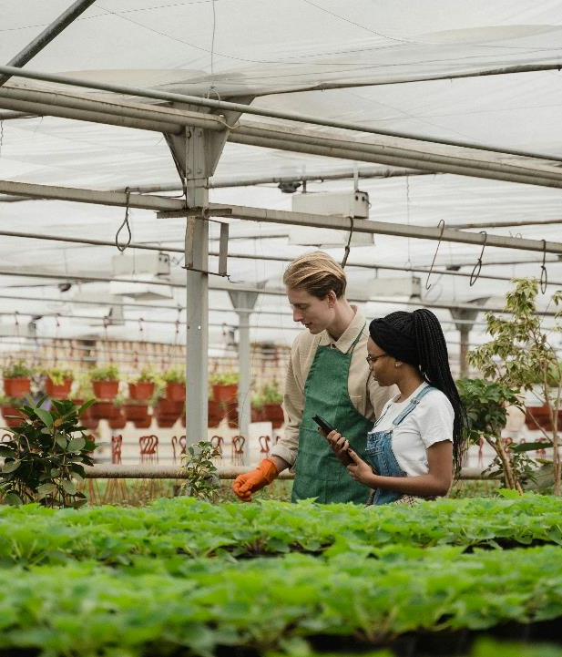
Their efforts in creating eco-friendly products and efficient waste management systems showcase their commitment to sustainability. Repot aps’ focus on reducing waste and promoting resource efficiency highlights the role of innovation in advancing circular economy principles.
Learn more about Repot aps’ solutions by visiting our Compendium of Case Studies.

Slide 39
SUSTAINABLE DEVELOPMENT GOALS ALIGNMENT
SDG 9 (Industry, Innovation, and Infrastructure): Lean management promotes efficient and sustainable industrial practices by optimising resource use and enhancing productivity.
SDG 12 (Responsible Consumption and Production): By reducing waste generation and improving resource efficiency, lean management contributes to sustainable consumption and production patterns.
SDG 8 (Decent Work and Economic Growth): Enhancing productivity and efficiency through lean practices supports economic growth and creates decent work opportunities.

Slide 40
ENTRECOMP ALIGNMENT
EntreComp 1.5 (Ethical and sustainable thinking): Assessing the impact of lean practices on sustainability encourages ethical decision-making and promotes sustainable management practices.
EntreComp 3.1 (Taking the initiative): Taking the initiative to implement lean methodologies involves identifying opportunities for improvement, making operational decisions, and encouraging organisational change towards sustainable practices.

Slide 41

Practical Exercise
5S Implementation
Objective: Apply the 5S methodology in a real or simulated workplace.
Instructions: Conduct a 5S audit of a workspace. Implement the 5S principles (Sort, Set in order, Shine, Standardise, Sustain) and report on the improvements.
Example: Perform a 5S audit in a classroom or office, organising supplies and equipment to improve efficiency and safety.
Tools Needed: 5S audit checklists, organisational tools, labelling supplies.

Slide 42
Further Resources
Kaizen: A Methodology For Developing The Continuous Improvement Culture
5S System: The lean way to workplace organisation for maximum efficiency
Lean Continuous Improvement: Origins, Principles & Goals

Slide 43

THE GLOBAL PERSPECTIVE & GREEN DEAL 2050
05

Slide 44

INTRODUCTION
Climate change, resource depletion, biodiversity loss, and social inequalities pose significant risks to global stability and economic prosperity.
Addressing these challenges requires collective action, innovative solutions, and commitment to achieving sustainable development goals (SDGs).
The European Green Deal 2050 represents a comprehensive policy framework aimed at transforming Europe into a climate-neutral continent by 2050. It encompasses initiatives to decarbonise industries, promote sustainable energy use, protect biodiversity, and create green innovation.

Slide 45
KEY GOALS AND INITIATIVES OF THE EUROPEAN GREEN DEAL 2050
The European Green Deal 2050 outlines ambitious goals and initiatives to achieve climate neutrality and environmental sustainability.
Key initiatives include reducing greenhouse gas emissions, enhancing energy efficiency, promoting circular economy practices, and investing in renewable energy sources.
The Green Deal aims to transition towards a resilient and resource-efficient economy while ensuring a just and inclusive transition for all stakeholders. By aligning policies, investments, and regulatory frameworks with sustainability objectives, the Green Deal seeks to create green jobs, stimulate economic growth, and improve quality of life across Europe.

Slide 46

REGIONAL DIFFERENCES IN ENVIRONMENTAL REGULATIONS
Environmental regulations differ significantly across regions, impacting how businesses operate in various markets. For instance, the European Union enforces strict regulations to reduce carbon emissions and promote renewable energy, while other regions may have less stringent laws.
Businesses must understand these differences to comply with local laws and adopt best practices tailored to regional standards.
This knowledge helps businesses avoid legal pitfalls and demonstrates a commitment to sustainability, which can enhance their reputation and operational efficiency.

Slide 47
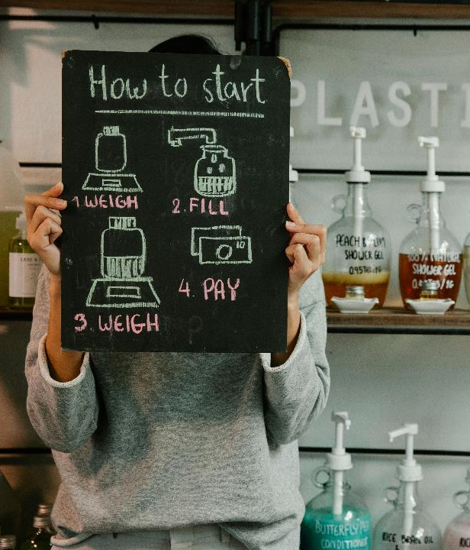
CONSUMER PREFERENCES AND MARKET TRENDS
Consumer demand for sustainable products and practices varies by region. In some areas, there is a strong preference for eco-friendly products, which drives businesses to innovate and offer sustainable alternatives.
In contrast, other regions may focus on cost and convenience over sustainability. By analysing these market trends, businesses can create their products and marketing strategies to meet the specific needs and preferences of their target audiences.
This approach not only enhances market position but also ensures that businesses remain competitive and relevant in markets.

Slide 48

INTERNATIONAL SUSTAINABILITY INITIATIVES
Several international initiatives and frameworks guide global sustainability efforts. The United Nations Sustainable Development Goals (SDGs) provide a comprehensive blueprint for achieving a more sustainable future by addressing global challenges such as poverty, inequality, and climate change.
The European Union's Circular Economy Action Plan focuses on promoting circular economy practices, encouraging businesses to design products that are reusable, repairable, and recyclable.
By aligning with these initiatives, businesses can contribute to global sustainability goals, enhance their credibility, and increase their competitiveness in the international market.

Slide 49
IMPACT ON BUSINESS PRACTICES
The Green Deal 2050 has profound implications for businesses operating within the European Union (EU) and beyond. It encourages companies to adopt sustainable business models, invest in green technologies, and integrate environmental considerations into decision-making processes.
Businesses are expected to adhere to stringent environmental standards, enhance resource efficiency, and disclose environmental impacts through transparent reporting.
The Green Deal promotes collaboration between public and private sectors, fostering innovation, research, and development of green technologies.

Slide 50
SUSTAINABLE DEVELOPMENT GOALS ALIGNMENT
SDG 13 (Climate Action): The European Green Deal 2050 promotes climate action through decarbonisation efforts, renewable energy investments, and sustainable development practices.
SDG 7 (Affordable and Clean Energy): By promoting renewable energy sources and energy efficiency measures, the Green Deal contributes to ensuring access to affordable, reliable, sustainable, and modern energy for all.
SDG 12 (Responsible Consumption and Production): Emphasising circular economy practices and sustainable production patterns, the Green Deal supports responsible consumption and production goals.

Slide 51
ENTRECOMP ALIGNMENT
EntreComp 1.5 (Ethical and sustainable thinking): Assessing the implications of the European Green Deal 2050 encourages ethical decision-making and promotes sustainable management practices.
EntreComp 2.1 (Self-awareness and self-efficacy): Understanding the global sustainability context and the Green Deal initiatives fosters self-awareness and self-efficacy in promoting sustainable business practices and assuming leadership roles in sustainability.

Slide 52
SUGGESTED PRACTICAL EXERCISE
Policy Impact Analysis of the European Green Deal 2050
Research: Conduct research on the European Green Deal 2050 and its key initiatives.
Impact Analysis: Analyse the potential impact of the Green Deal on specific industries or businesses.
Presentation: Present findings to the group, highlighting the opportunities and challenges posed by the Green Deal.
Discussion: Engage in a group discussion on how businesses can adapt to and benefit from the Green Deal.

Slide 53

POLICY AND REGULATION FOR CIRCULAR ECONOMY ADOPTION
06

Slide 54

INTRODUCTION
Regionalisation involves creating policies and strategies to the unique socio-economic, environmental, and cultural contexts of specific regions.
This approach ensures that sustainability efforts are relevant, effective, and inclusive, addressing local needs and leveraging regional strengths.
54

Slide 55



Context-Specific Strategies
Developing policies that consider the local context, including economic conditions, cultural norms, and environmental challenges.
Stakeholder Engagement
Involving local communities, businesses, and governments in the development and implementation of policies.
Capacity Building
Strengthening local institutions, skills, and resources to support sustainable development.

Slide 56

ROLE OF POLICY AND REGULATION
Policies and regulations play a crucial role in encouraging businesses to adopt circular economy practices.
Governments set standards and create frameworks that compel industries to reduce waste, enhance resource efficiency, and promote sustainable practices. These regulations ensure that businesses take responsibility for the environmental impact of their operations and products throughout their lifecycle.
Government Initiatives: Government initiatives are essential in supporting the transition to a circular economy. These initiatives often include:

Slide 57

INCENTIVES AND SUBSIDIES
Financial support for businesses that invest in sustainable technologies and practices.
These can take various forms, such as tax breaks, grants, and low-interest loans, which reduce the financial burden of adopting eco-friendly practices.
For example, subsidies might be provided to companies that invest in renewable energy systems, energy-efficient equipment, or waste reduction technologies.

Slide 58

REGULATORY STANDARDS
Mandatory guidelines that ensure businesses meet specific environmental criteria. These standards often cover a range of areas, including waste management, emissions control, and product design.
For instance, regulations may require companies to limit their carbon emissions, use recyclable materials in their products, or adhere to strict waste disposal practices.

Slide 59

PUBLIC-PRIVATE PARTNERSHIPS
Collaborations between governments and businesses to develop innovative circular economy solutions. These partnerships highlight the strengths and resources of both sectors to address sustainability challenges more effectively.
For example, governments may partner with tech companies to develop advanced recycling technologies or work with manufacturing firms to create closed-loop production systems.
Public-private partnerships can also facilitate knowledge sharing and the scaling of successful pilot projects to broader applications, accelerating the transition to a circular economy.

Slide 60

EDUCATIONAL AND AWARENESS CAMPAIGNS
Governments often run campaigns to educate businesses and the public about the benefits of a circular economy.
These initiatives aim to change consumer behaviour and increase demand for sustainable products and services.
By raising awareness, governments can create a culture of sustainability that supports long-term environmental goals. Educational programmes might include workshops, seminars, and online resources that provide businesses with the knowledge and tools they need to implement circular practices.

Slide 61

LEGISLATION AND POLICY FRAMEWORKS
Comprehensive policies and legislative measures provide a structured approach to implementing circular economy principles.
Governments may introduce laws that mandate recycling, ban single-use plastics, or set targets for waste reduction. Policy frameworks can also outline long-term strategies for resource management, aligning national goals with global sustainability targets.
For example, the European Union’s Circular Economy Action Plan sets a clear roadmap for transitioning to a circular economy by 2050, with specific milestones and actions for member states.

Slide 62

RESEARCH AND DEVELOPMENT SUPPORT
Funding and support for research and development (R&D) are crucial for advancing circular economy technologies.
Governments can provide grants and incentives for R&D projects that focus on sustainable materials, waste-to-energy processes, and other innovative solutions.
By investing in R&D, governments help drive technological advancements that enable businesses to adopt more sustainable practices.
Collaboration with academic institutions and research organisations can also lead to breakthroughs that make circular economy principles more viable and cost-effective.

Slide 63
SUSTAINABLE DEVELOPMENT GOALS ALIGNMENT
SDG 11 (Sustainable Cities and Communities): Promotes inclusive and sustainable urbanisation through context-specific policies and stakeholder engagement.
SDG 16 (Peace, Justice, and Strong Institutions): Strengthens local institutions and promotes inclusive decision-making processes.
SDG 17 (Partnerships for the Goals): Encourages collaboration between local, regional, and international stakeholders to achieve sustainable development goals.

Slide 64
ENTRECOMP ALIGNMENT
EntreComp 2.3 (Mobilising resources): Engaging local stakeholders and leveraging regional resources for sustainable development.
EntreComp 3.4 (Working with others): Collaborating with diverse stakeholders to develop and implement context-specific policies.

Slide 65
SUGGESTED PRACTICAL EXERCISE
Step-by-Step Instructions for Practical Exercise:
Policy Analysis: Analyse existing country policies and their regionalisation efforts.
Case Study: Study a successful regionalisation initiative and its impact on sustainable development.
Policy Proposal: Develop a policy proposal for regionalising a specific sustainability initiative in your own context.
Presentation: Present the policy proposal to the class, highlighting the regional context, stakeholder engagement, and expected outcomes.

Slide 66

Follow our journey here

