Slide 1

Module 3
Market Analysis & Digital Marketing for Sustainable Ventures
www.fairpreneurs.eu
Co-funded by the European Union. Views and opinions expressed are however those of the author or authors only and do not necessarily reflect those of the European Union or the Foundation for the Development of the Education System. Neither the European Union nor the entity providing the grant can be held responsible for them. KA220-YOU-DF4BEA29
This study is available under the CC BY-NC-SA license.

Slide 2
TABLE OF CONTENTS
01
Introduction to Market Analysis & Digital Marketing
02
Market Analysis & Sustainable Opportunity
03
The Importance of Digital Marketing
04
Strategies for Effective Online Presence
05
Storytelling
06
Sustainability Reporting

Slide 3

INTRODUCTION TO MARKET ANALYSIS & DIGITAL MARKETING FOR SUSTAINABLE VENTURES
01

Slide 4
INTRODUCTION TO MARKET ANALYSIS FOR SUSTAINABLE VENTURES
Why Market Analysis Matters
Market analysis serves as a major player for businesses aiming to identify sustainable business opportunities and understand consumer preferences in today's market landscape.
It helps businesses understand the market environment, including the competitive landscape and consumer needs.
It is essential for developing strategies that align with market demands and ensuring business sustainability.

Slide 5
BY CONDUCTING THOROUGH MARKET ANALYSIS, BUSINESSES CAN:
Identify Sustainable Business Opportunities: Market analysis helps businesses identify gaps and opportunities in the market where sustainable solutions can make a significant impact. Whether it's addressing environmental concerns, social issues, or ethical considerations, market analysis provides valuable insights into areas ripe for sustainable innovation.
Understand Consumer Preferences: Consumer preferences are constantly evolving, with an increasing emphasis on sustainability and ethical consumption. Market analysis allows businesses to stay ahead of these trends by understanding what influences consumer behaviour and decision-making. By aligning their offerings with consumer values and preferences, businesses can create products and services that resonate with their target audience.

Slide 6

BENEFITS OF EFFECTIVE MARKET ANALYSIS
Market analysis provides invaluable insights that guide businesses in making informed decisions, helping them allocate resources effectively and develop products that meet consumer needs.
By understanding market size, growth potential, and competitive landscape, businesses can strategise based on solid data.
This approach not only ensures that resources are focused on high-potential areas but also enhances the likelihood of product success and market acceptance.

Slide 7



Identifying Trends
Market analysis helps businesses stay ahead by identifying emerging trends and shifts in consumer behaviour, allowing for quick adaptation and capitalisation on new opportunities.
Benchmarking
By benchmarking performance against industry standards, businesses can identify areas for improvement and differentiate themselves from competitors.
Customer Loyalty
Aligning products with consumer values, especially sustainability, builds stronger customer loyalty and enhances brand reputation.

Slide 8
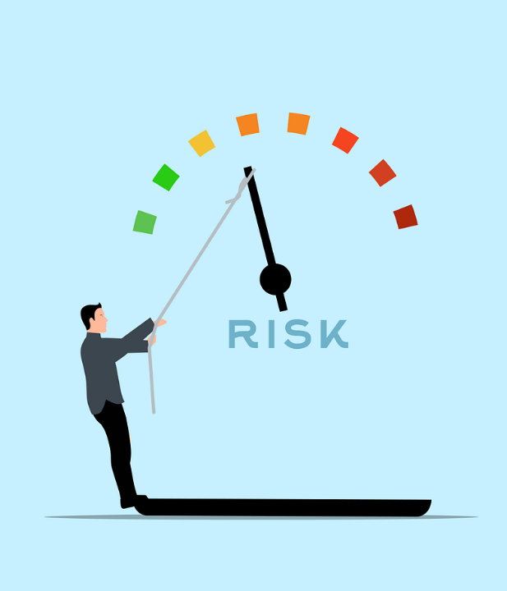
RISK MITIGATION
Identifying Risks: Market analysis helps identify potential market risks, such as economic downturns, changing regulations, or shifts in consumer preferences.
Scenario Planning: Businesses can use market analysis for scenario planning, preparing for various market conditions to enhance resilience.
Risk Management Strategies: Implementing strategies like diversifying product lines or entering new markets helps reduce vulnerability and ensure long-term stability.

Slide 9

TECHNIQUES FOR RECOGNISING SUSTAINABLE BUSINESS OPPORTUNITIES
In this section, we will explore the techniques for recognising sustainable business opportunities in more detail.
By mastering these methodologies, businesses can identify unmet sustainability needs and develop innovative solutions that encourage positive change.
9

Slide 10


Market Research
Market research involves conducting in-depth analysis of consumer trends and preferences, allowing businesses to identify areas where sustainability concerns intersect with consumer demands. Using tools like SurveyMonkey or Google Forms for market research surveys enables businesses to gather valuable insights into consumer behaviour and preferences.
Trend Analysis
Staying updated on emerging sustainability trends and developments is essential for businesses seeking to innovate sustainably. Monitoring industry reports, publications, and online resources like TrendWatching.com provides valuable insights into the latest sustainability trends, enabling businesses to adapt their strategies accordingly.

Slide 11


Stakeholder Engagement
Engaging with stakeholders is key to understanding their sustainability preferences and gathering insights that inform business decisions. Through interviews, focus groups, or workshops, businesses can work with stakeholders to co-create sustainable solutions that meet their needs.
Developing Innovate Solutions
Using insights gathered from market research, trend analysis, and stakeholder engagement, businesses can develop innovative solutions that address sustainability challenges while meeting consumer needs and preferences. Launching a sustainable product line based on feedback from stakeholders exemplifies the outcome of applying these techniques in practice.

Slide 12

SUGGESTED PRACTICAL EXERCISE
Market Analysis Workshop
Objective: Conduct a market analysis for a sustainable business idea.
Survey Creation: Use SurveyMonkey or Google Forms to create a survey on sustainability preferences.
Data Collection: Distribute the survey and analyse results for trends and market gaps.
Opportunity Identification: Brainstorm sustainable business ideas based on survey insights.
Discussion: Evaluate opportunities for feasibility and ethical considerations.
Outcome: Gain practical experience in sustainable market analysis and identifying viable opportunities.

Slide 13


SDGS AND ENTRECOMP ALIGNMENT
Goal 12: Responsible Consumption and Production: Analyse how sustainable business practices contribute to reducing waste generation, promoting resource efficiency, and fostering sustainable consumption patterns.
Goal 13: Climate Action: Explore opportunities to mitigate climate change impacts through sustainable products/services and eco-friendly practices.
2.1 Self-awareness and self-efficacy: Believe in yourself and keep developing: Promote one's business, assume responsibility for the management of a business.
3.1 Opportunity Recognition: Identify and evaluate sustainable business opportunities based on market analysis and consumer insights.
3.2 Strategic Thinking: Develop strategic plans to capitalise on sustainable trends and consumer preferences.
3.3 Sense of Initiative and Entrepreneurship: Proactively engage in market analysis to innovate and create sustainable ventures that address societal challenges.

Slide 14

FURTHER RESOURCES
The Importance of Conducting a Market Analysis Before Company Formation
Opportunities and Challenges of Sustainable Marketing Practices in Emerging Markets
Consumer Trends & Insights for 2024. TrendWatching is a leading resource for consumer trends, insights and innovations.

Slide 15

THE IMPORTANCE OF DIGITAL MARKETING
02

Slide 16

THE IMPORTANCE OF DIGITAL MARKETING
Digital marketing helps businesses effectively communicate their sustainability efforts, engage with environmentally-conscious consumers, and create positive outcomes.
By using digital marketing strategies, sustainable ventures can increase their impact and inspire action towards a more sustainable future.
16

Slide 17

REACHING TARGET AUDIENCES EFFECTIVELY
Digital marketing channels such as social media (e.g., Facebook, Instagram, Twitter/X), email marketing, and SEO offer efficient means to connect with consumers.
Tools like Facebook Business Manager, Mailchimp, businesses can precisely target audiences based on demographics, interests, and behaviours, ensuring that their messaging resonates with sustainability values.
This targeted approach increases the impact of marketing efforts, increasing engagement and conversion among environmentally-conscious consumers.
17

Slide 18

COMMUNICATING SUSTAINABILITY VALUES
Digital marketing provides a platform for businesses to showcase their sustainability initiatives and values to a broad audience.
Using platforms like Instagram, businesses can share compelling content and stories that highlight their commitment to sustainability.
By authentically communicating their sustainability journey and demonstrating actions, businesses can build credibility and trust among environmentally-conscious consumers, encouraging long-term loyalty and advocacy.
18

Slide 19

BUILDING BRAND AWARENESS
Tools like Hootsuite and Buffer empower businesses to streamline their digital marketing efforts across various platforms, ensuring consistency and coherence in brand messaging.
By consistently sharing valuable content, engaging with their audience, and participating in relevant conversations, businesses can enhance their brand presence and position themselves as leaders in sustainability, driving awareness and attracting new customers.
19

Slide 20


BEST PRACTICES:
BIASOL
Biasol shows effective market analysis and digital marketing for sustainable ventures by leveraging their unique zero-waste food products.

Slide 21

Founded in 2020, Biasol repurposes spent brewing grain into nutritious ingredients, addressing food waste and promoting a circular economy.
Their strategic use of digital marketing highlights their innovative approach and aligns with market trends favouring sustainability.
Explore how Biasol’s market analysis and digital marketing strategies drive their sustainable food solutions by visiting our Compendium of Case Studies.

Slide 22
SUGGESTED PRACTICAL EXERCISE
Social Media Challenge
Objective: Create an interactive social media challenge to promote a sustainability message.
Steps:
Form Teams: Split into small groups.
Develop a Challenge: Each team creates a simple, fun challenge related to sustainability (e.g., a recycling tips challenge).
Create Content: Use tools like Canva to design posts and graphics for the challenge.
Plan Promotion: Outline a strategy to promote the challenge on social media platforms.
Present & Share: Share the challenge ideas with the class.
Outcome: Participants will learn to create engaging content and plan promotional strategies.

Slide 23


SDGS AND ENTRECOMP ALIGNMENT
SDG 4: Quality Education: Promoting knowledge dissemination about digital marketing practices and sustainability.
SDG 12: Responsible Consumption and Production: Raising awareness about sustainable products and practices through digital marketing.
EntreComp 2.1 Self-awareness and self-efficacy: Promote one's business, assume responsibility for the management of a business.
EntreComp 3.1 Taking the initiative: Identify opportunities, make operational decisions independently, make strategic business decisions.

Slide 24
FURTHER RESOURCES
Sustainable Digital Marketing: Redefining Success for 2024
Driving Growth Responsibly: The Rise of Sustainable Digital Marketing Strategies
Leveraging social media to examine sustainability communication of home appliance brands

Slide 25

STRATEGIES FOR EFFECTIVE ONLINE PRESENCE
03

Slide 26

STRATEGIES FOR EFFECTIVE ONLINE PRESENCE
Let’s have a look into the key tactics that sustainable projects should focus on to create an effective online presence that encourages meaningful connections with their audience.
Implementing these strategies will not only help sustainable projects establish a strong online presence but also position them for long-term success in the digital landscape.

Slide 27

WEBSITE DEVELOPMENT
The foundation of a strong online presence begins with a well-designed website that embodies the values and mission of the sustainable project.
Businesses should focus on creating a user-friendly website that reflects their commitment to sustainability, incorporating eco-friendly design elements and ensuring it’s easily accessible, visually appealing, and optimised for mobile devices.
Website development platforms like WordPress or Wix and Squarespace along with tools like Shopify, can facilitate this process, offering customisable templates tailored to sustainability themes and seamless mobile optimisation.
27

Slide 28

CONTENT CREATION
Compelling and informative content is essential for attracting and engaging online audiences. Businesses can take advantage of popular content creation tools like Canva or Adobe Express to design visually appealing graphics and videos that complement their sustainability message.
Businesses should also develop a content strategy that focuses on creating valuable and relevant content related to sustainability.
This could include blog posts, articles, case studies, videos, and infographics that educate consumers about sustainability issues, showcase the company's sustainability initiatives, and highlight the environmental and social impact of its products or services.
28

Slide 29

SOCIAL MEDIA MARKETING
Social media platforms provide valuable opportunities for businesses to connect with their audience, highlight their sustainability message, and encourage community engagement.
Sustainable businesses can develop a strategic social media marketing plan, using tools like Hootsuite or Buffer to schedule posts and monitor engagement.
By sharing behind-the-scenes stories, showcasing user-generated content, and participating in conversations about environmental and social issues, businesses can humanise their brand, build relationships with customers, and create a loyal community of environmentally-conscious supporters.
29

Slide 30


BEST PRACTICES:
ALL ABOUT KOMBUCHA
All About Kombucha uses digital marketing strategies and effective online presence to engage with eco-conscious consumers, focusing on market analysis.

Slide 31

Their approach illustrates how market insights and digital tools can be used to promote sustainable products.
Their successful use of digital platforms to reach and engage a target audience demonstrates the impact of market analysis and digital marketing on embracing consumer demand for sustainable goods.
Learn more about All About Kombucha by visiting our Compendium of Case Studies.

Slide 32
SUGGESTED PRACTICAL EXERCISE
Stakeholder Mapping and Engagement
Objective: Identify and engage stakeholders for a sustainability project.
Stakeholder Identification: List key stakeholders (e.g., community, suppliers, regulators).
Engagement Strategy: Develop approaches to involve stakeholders in sustainability efforts.
Action Plan: Outline steps to implement engagement strategies.
Reflection: Discuss effectiveness and potential improvements.
Outcome: Improved stakeholder management skills for sustainable initiatives.

Slide 33
SUSTAINABLE DEVELOPMENT GOALS ALIGNMENT
SDG 9: Industry, Innovation, and Infrastructure: Explores innovative technological aspects of online presence, emphasising the role of digital infrastructure in sustainable business practices.
SDG 11: Sustainable Cities and Communities: Highlights the importance of online presence in community engagement, creating sustainable urban development through digital connectivity.
SDG 12: Responsible Consumption and Production: Promotes sustainable and responsible content creation, encouraging businesses to communicate and promote sustainable consumption practices online.

Slide 34
SUSTAINABLE DEVELOPMENT GOALS ALIGNMENT
SDG 13: Climate Action: Communicates climate-friendly practices through online content, supporting initiatives that promote climate resilience and reduction efforts.
SDG 17: Partnerships for the Goals: Emphasises collaboration through social media for sustainable partnerships, promoting cross-sectoral cooperation towards achieving sustainability objectives.

Slide 35

ENTRECOMP ALIGNMENT
2.1 Self-awareness and self-efficacy: Encourages individuals to promote their sustainable ventures effectively and be accountable for their digital presence.
3.1 Taking the initiative: Promotes initiative in identifying online opportunities, making strategic decisions, and managing digital strategies independently.
3.3 Coping with uncertainty, ambiguity & risk: Develop skills in risk management and decision-making related to digital presence and online strategies.

Slide 36
Further Resources
The Impact of Online Presence on Business Growth
Sustainability In Social Media Marketing: 7 Strategies For Promoting Your Eco-Conscious Brand

Slide 37




Slide 38

STORYTELLING FOR SUSTAINABILITY
04

Slide 39

THE POWER OF STORYTELLING
Storytelling is a powerful tool in communicating sustainability messages and creating a deep emotional connection with stakeholders.
Effective storytelling can make complex sustainability issues more relatable and inspire people to take action.
By weaving facts and data into your narratives, businesses can highlight their sustainability efforts, demonstrate their commitment to positive change, and engage their audience on a deeper level.
39

Slide 40



Authenticity
Ensure that the story is genuine and reflects the true values and actions of the business. Authenticity builds trust and credibility.
Relevance
Create the story to the interests and concerns of the target audience. Making the narrative relevant to their lives and values increases its impact.
Impact
Highlight the benefits and positive outcomes of sustainability initiatives. Showcasing real-world impact can inspire and motivate them to support and participate in these efforts.

Slide 41

COMMUNICATING SUSTAINABILITY MESSAGES
Storytelling allows businesses to convey complex sustainability concepts in an engaging and relatable way.
By sharing stories about their sustainability journey, challenges, and successes, businesses can make their initiatives more accessible and understandable to their audience.
This can include case studies of specific projects, testimonials from employees or customers, and behind-the-scenes looks at sustainability practices.
41

Slide 42

BUILDING EMOTIONAL CONNECTIONS
Through storytelling, businesses can connect with their audience on a deeper emotional level. Sharing authentic stories about the positive impact of their sustainability efforts helps to humanise the brand and create a sense of shared purpose with stakeholders.
Emotional narratives that highlight real-life examples, such as community impact or environmental restoration, can connect strongly with audiences and create lasting bonds.
42

Slide 43
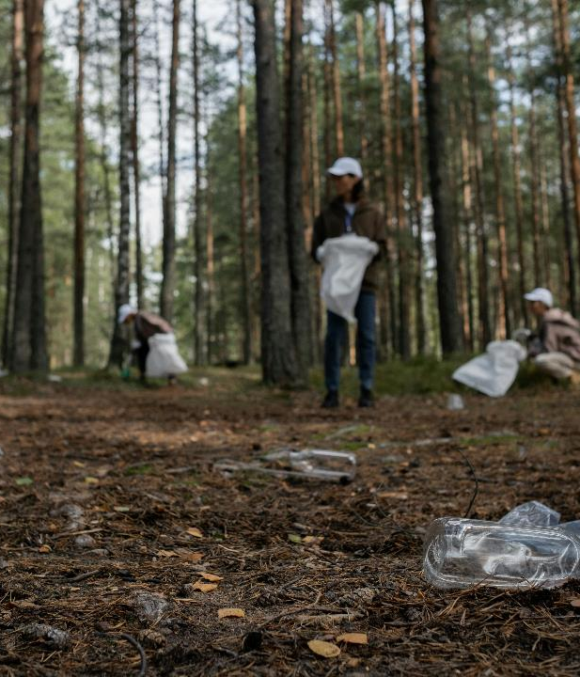
INSPIRING ACTION
Compelling narratives can motivate stakeholders to take action, whether it’s supporting the business, adopting sustainable practices, or spreading the word about sustainability initiatives.
By highlighting the benefits and real-world impact of their efforts, businesses can encourage others to join their sustainability journey.
Stories that showcase measurable results and personal experiences can be particularly effective in inspiring action and commitment.
43

Slide 44
SUGGESTED PRACTICAL EXERCISE
Sustainability Storytelling Workshop
Objective: Craft a compelling sustainability story.
Scenario Assignment: Divide into groups and receive a sustainability scenario. (sustainable fashion or eco-friendly product launches.)
Story Development: Brainstorm and craft a narrative highlighting sustainability values.
Presentation Preparation: Prepare to share the story with the class.
Feedback Session: Provide constructive feedback on each other’s narratives.
Outcome: Enhanced skills in creating impactful sustainability stories, integrating cultural and ethical considerations.

Slide 45
SUSTAINABLE DEVELOPMENT GOALS ALIGNMENT
SDG 4: Quality Education: Emphasises educational aspects of storytelling by teaching how effective narratives can educate and inform audiences about sustainability issues and practices.
SDG 12: Responsible Consumption and Production: Promotes transparency in business narratives by encouraging the crafting of stories that highlight responsible consumption, sustainable production practices, and transparent communication about these efforts.
SDG 13: Climate Action: Uses storytelling for climate awareness by illustrating the impacts of climate change through narratives, advocating for sustainable practices, and inspiring action towards climate mitigation and adaptation.

Slide 46
SUSTAINABLE DEVELOPMENT GOALS ALIGNMENT
SDG 16: Peace, Justice, and Strong Institutions: Supports social equity through stories that promote justice, fairness, and inclusivity, thereby contributing to the creation of strong institutions and promoting social cohesion.
SDG 3: Good Health and Well-being: Illustrates the emotional impacts of storytelling by exploring how narratives can positively influence well-being, raise awareness about mental health issues related to sustainability, and inspire actions that contribute to better health outcomes.

Slide 47
ENTRECOMP ALIGNMENT
2.1 Self-awareness and self-efficacy: Through crafting sustainability narratives, the unit promotes self-awareness and belief in one's ability to effectively communicate values and engage audiences.
3.1 Taking the initiative: Learners are encouraged to independently develop strategic storytelling approaches that effectively convey sustainability messages and resonate with their intended audience.

Slide 48
ENTRECOMP ALIGNMENT
3.3 Coping with uncertainty, ambiguity & risk: The unit guides learners in navigating the complexities of storytelling, including ethical considerations and cultural sensitivities, preparing them to manage risks inherent in narrative creation.
2.5 Mobilising others: By emphasising the power of storytelling to inspire action and empathy, the unit equips students with skills to move others toward sustainable practices and social change.

Slide 49
Further Resources
The Power Of Storytelling For Your Business: Unleashing Your Inner Storyteller
The Power of Storytelling in Promoting Sustainable Consumption
Storytelling to save the planet

Slide 50

SUSTAINABILITY REPORTING
05

Slide 51

INTRODUCTION
Sustainability reporting has evolved from a mere disclosure of environmental impacts to a comprehensive communication tool that integrates economic, environmental, social, and governance (ESG) factors.
This unit aims to equip you with essential knowledge and skills to understand, prepare, and communicate sustainability reports effectively.
51

Slide 52
INTRODUCTION TO SUSTAINABILITY REPORTING
Sustainability reporting involves the communication of environmental, social, and governance (ESG) aspects of an organisation's operations. It aims to provide transparency to stakeholders about the organisation's sustainability efforts and impacts. This practice has become increasingly important in modern business as stakeholders, including investors, customers, employees, and communities, demand greater accountability and responsibility from organisations.
Transparent sustainability reporting enhances trust and credibility with stakeholders. It allows organisations to demonstrate their commitment to sustainable practices, which can positively impact brand reputation and customer loyalty.

Slide 53
PRINCIPLES AND FRAMEWORKS OF SUSTAINABILITY REPORTING
In sustainability reporting, effective methods for collecting and analysing data are crucial for organisations to assess their environmental, social, and governance (ESG) impacts accurately.
This process enables businesses to measure their sustainability performance transparently, meeting stakeholder expectations for accountability.
53

Slide 54

OVERVIEW OF GLOBAL REPORTING INITIATIVE (GRI) STANDARDS
The Global Reporting Initiative (GRI) provides a comprehensive framework for sustainability reporting widely used by organisations globally.
GRI Standards help organisations disclose their economic, environmental, and social impacts through a standardised reporting process.
These standards ensure that organisations report relevant and comparable information, enhancing transparency and accountability.
54

Slide 55

IMPORTANCE OF INTEGRATED REPORTING
Integrated Reporting combines financial and non-financial information into a single report, providing a holistic view of an organisation's performance.
It emphasises the interconnectedness between financial performance and ESG factors, promoting a more balanced and informed assessment of organisational value creation.
Integrated Reporting supports comprehensive sustainability disclosure by encouraging organisations to consider how sustainability impacts financial outcomes and vice versa.
”
55

Slide 56
METHODS FOR GATHERING SUSTAINABILITY DATA
Quantitative data involves numerical metrics like greenhouse gas emissions and energy consumption, offering insights into environmental impacts. Qualitative data, on the other hand, captures non-numeric information such as stakeholder perceptions and community relations, providing valuable social and governance insights.
Surveys and Interviews: Engage stakeholders to gather qualitative feedback.
Audits and Assessments: Conduct reviews to ensure compliance with sustainability goals.
Automated Systems: Implement IoT sensors for real-time monitoring of environmental metrics.

Slide 57

TOOLS AND TECHNOLOGIES
Excel is a versatile tool for basic data manipulation and quantitative analysis.
It allows users to perform calculations and statistical analyses, create detailed spreadsheets to track sustainability metrics, and develop charts and graphs to visualise data trends.
Its accessibility and functionality make it a foundational tool for initial data processing.
57

Slide 58

TOOLS AND TECHNOLOGIES
Data visualisation tools, such as Tableau, enable interactive visualisation of sustainability trends.
These tools help organisations transform raw data into insightful, interactive dashboards.
By identifying patterns and trends through visual analytics, companies can share visual reports with stakeholders, creating better understanding and engagement.
”
58

Slide 59

TOOLS AND TECHNOLOGIES
Specialised sustainability reporting software streamlines comprehensive data collection, analysis, and reporting.
These platforms integrate capabilities to collect data from various sources automatically, offer advanced analytics to assess sustainability performance against benchmarks, and provide templates and guidelines to ensure reports meet global standards such as the Global Reporting Initiative (GRI) and the Carbon Disclosure Project (CDP).
”
59

Slide 60
SUGGESTED PRACTICAL EXERCISE
Sustainability Report Workshop
Objective: Create a mock sustainability report.
Form Teams: Divide into small groups.
Data Collection: Use provided data sets.
Report Writing:
Analyse data.
Structure the report with ESG factors.
Create visual aids (charts, graphs).
Presentation: Share reports with the class.
Feedback: Discuss strengths and areas for improvement.
Outcome: Develop practical skills in sustainability reporting.

Slide 61
SUSTAINABLE DEVELOPMENT GOALS ALIGNMENT
SDG 16: Peace, Justice, and Strong Institutions: Promotes accountability and transparency in business through sustainability reporting, enhancing institutional integrity and creating inclusive societies.
SDG 13: Climate Action: Uses sustainability reporting to disclose environmental impacts and risks, promoting awareness, encouraging sustainable practices, and supporting global climate action efforts.
SDG 12: Responsible Consumption and Production: Advocates for sustainable business practices through transparent reporting on consumption, resource use, and production impacts, creating sustainable production methods and reducing environmental footprints.

Slide 62
SUSTAINABLE DEVELOPMENT GOALS ALIGNMENT
SDG 8: Decent Work and Economic Growth: Emphasises transparency in economic activities via sustainability reporting, disclosing social impacts and labour practices to promote inclusive economic growth and decent work conditions.
SDG 17: Partnerships for the Goals: Aligns with global reporting standards like GRI, fostering partnerships among businesses, governments, and stakeholders to enhance reporting effectiveness, transparency, and accountability toward sustainable development goals.

Slide 63
ENTRECOMP ALIGNMENT
3.1 Taking the initiative: Encourages independent decision-making in data collection, analysis, and reporting practices.
3.3 Coping with uncertainty, ambiguity & risk: Guides decision-making in navigating complex sustainability issues and reporting challenges.

Slide 64
Further Resources
Get started with reporting
Sustainability Reporting in the Era of ESG: Best Practices and Emerging Trends

Slide 65

Follow our journey here

